Slide 1
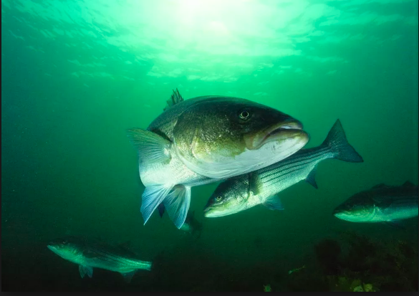
Striped Bass: Commercial Fishing
Katie Ginn and Cecily Russo, Lincoln School, Providence, RI
Notes:
Game pieces
Print cards

Slide 2
Introduction & Background
What is the difference between commercial and recreational fishing?
Commercial fishing: the act of catching fish for profit, and it provides a large amount of food for many countries around the globe.
Recreational fishing: when one fishes just for the fun of it, for consumption and sometimes for competitions.
It is a common misconception that commercial fishing is the main cause of rapid decline in striped bass populations. It is the combination of both recreational and commercial fishing if it goes unrestricted.
In this lesson plan we will dive deeper into the regulations surrounding commercial fishing and how they work to protect striped bass while still allowing fishers to catch and keep enough to continue doing so.

Slide 3
Striped Bass: Habitat and Migration
Striped bass are found along coastal waters on the North American Atlantic coast, and are most prevalent from Maine to North Carolina. They have also been introduced to the West Coast and to lakes and river systems.
The striped bass undergoes two migrations: spawning migration and coastal migration. During the spawning migration, they move to fresh water to reproduce. The major spawning areas include the Chesapeake Bay, Delaware Bay, and Hudson River. After they spawn, they move to saltwater for coastal migration to the north. They end up in Rhode Island, Massachusetts, and Connecticut, then continuing to Maine, New Hampshire and as far north as the maritime provinces for the summer. In the fall, they migrate back to the southern part of their habitat and end up congregating near the Carolinas.

Slide 4
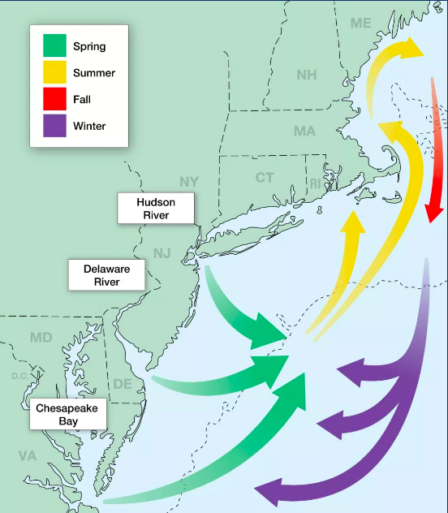
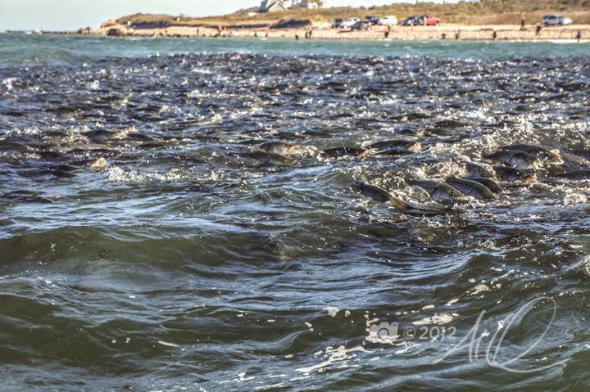
← Migration Map

Slide 5
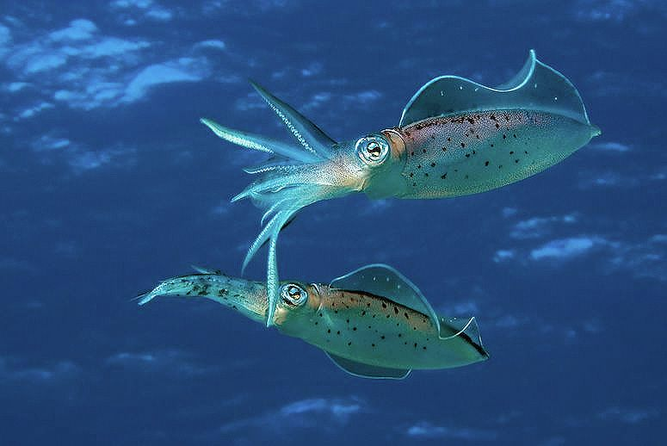
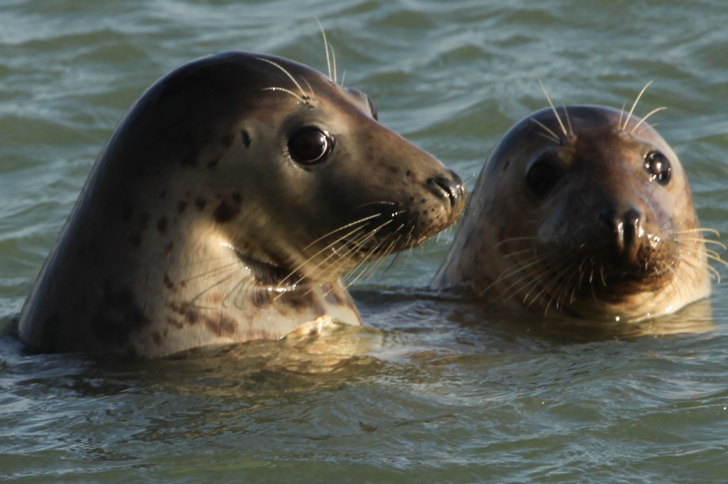
Predators and Prey
Prey
The diet of striped bass varies based on their developmental stage.
Adults
Vertebrate species such as smaller fish
Invertebrates such as worms, crabs, mussels, and squid
Predators
Predators of adult striped bass include humans, seals, sharks, Atlantic cod, bluefish, and some predatory birds like osprey.

Slide 6
Fishing: Recreational vs Commercial
Recreational
Angling (rod and reel)
For fun or competitive purposes
Done in light boats
Rods, reels, hooks, and bait
Commercial
Industrial fishing
Provides seafood supply for markets.
Some states use nets and traps instead of fishing rods
In MA and RI traps cannot be used, and commercial fishing must be done with rod and reel.
Career; supplies part of livelihood

Slide 7
Endangerment and Conservation
Striped bass were endangered due to overfishing along with negative impacts on their habitats from humans (water/air pollution, global warming, runoff.. etc.)
Striped Bass populations declined in the 1970’s and 1980’s with the commercial catch dropping from 14.7 million pounds in 1973 to 1.7 million pounds in 1983. This decline resulted from both overfishing and habitat quality decline.
To conserve the population of striped bass, laws and regulations surrounding commercial and recreational fishing were put in place and are reviewed yearly by the Atlantic States Marine Fisheries Commission. These regulations have had an extremely positive impact on the striped bass fishery.

Slide 8
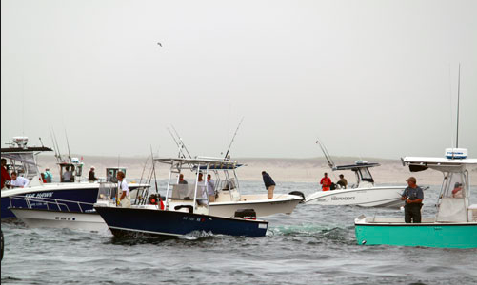
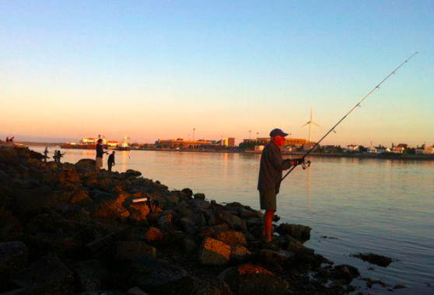
Laws and Regulations
Massachusetts
2018 MA Recreational Regulations:
Minimum for general fishing: 28”
Period: 1/1-12/31
Daily Max: 1 fish per person per day.
2018 MA Commercial Regulations:
Minimum for general fishing: 34”
Period: 5/20 - 8/4, 8/5 - 12/31, CLOSED Sun, Tues, Wed, Fri, Sat; the season ends when a quota is met.
Daily Max: 15

Slide 9
Purpose of Game
Demonstrate to students how regulations of commercial fishing protect striped bass while also affecting the business in commercial fishing.
Show how the regulations have affected the industry (struggles within the industry to meet requirements) and their effects on the environment (positive effects on populations)
Overall, to simulate a commercial fisher’s reality!

Slide 10
Board Game Directions!
⦿ Players will independently choose if they would like to play as a commercial fisher or a recreational fisher. Keep in mind that the two should be fairly even within the group playing in order to simulate both groups.
⦿ Each player picks a game piece to represent them on the board.
⦿ Place cards in the center of the board, face down.
⦿ All players will begin on Sunday, at the top of the board.
⦿ Decide who will go first, and then rotate around the circle with every turn.
⦿ When it is your turn, you will roll the die and move clockwise the number that the die says.
Recreational Fisher:
⦿ Every day you will be able to select a card, but you can only keep one fish per person per day, and abide by the rules on each individual card as well.
Commercial Fisher:
⦿ You will only be able to select a card if you land on a Monday or a Thursday, since those are the only two days that it is allowed for you to fish. You can only keep 15 fish per person per day. Abide by rules on each individual card as well.
⦿ The game continues until the cards run out.
⦿ At the end of the game, each person will count the amount of fish they were able to keep.
⦿ For an added exercise to show profits, you will calculate how much money you made based on the weight (in lbs) of each fish you caught. This will further demonstrate the difference between commercial and recreational fishing. Although market value varies, we will use the following price/lb numbers.
⦿ Striped bass: $3-$4 per lb
⦿ Tautog: $4.35 per lb

Slide 11
Sources
http://www.stripedbassmagic.org
http://www.stripertracker.org/habitat/
http://www.dem.ri.gov/programs/fish-wildlife/marine-fisheries/mfsizes.php#commer12
https://www.mass.gov/files/documents/2016/08/no/2016-commercial-striped-bass-fishery-rule-reminder-24jun16.pdf
https://alquattrocchi.wordpress.com/2012/10/10/the-great-fall-migration/
https://www.onthewater.com/news/2014/03/11/massachusetts-2014-commercial-striped-bass-regulations-announced

