Slide 1
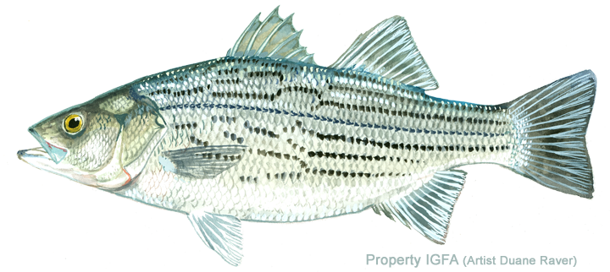
Striped bass: Predators and Prey
Kiera Murphy, Lincoln School, Providence, RI
Notes:
Today we will be talking about prey and predators of the striped bass.

Slide 2
What is a predator and what is a prey?
Prey
Predator
An animal that is hunted and killed by another animal for food
An animal that naturally preys on others
Notes:
Ask for examples and ask for their definitions.

Slide 3
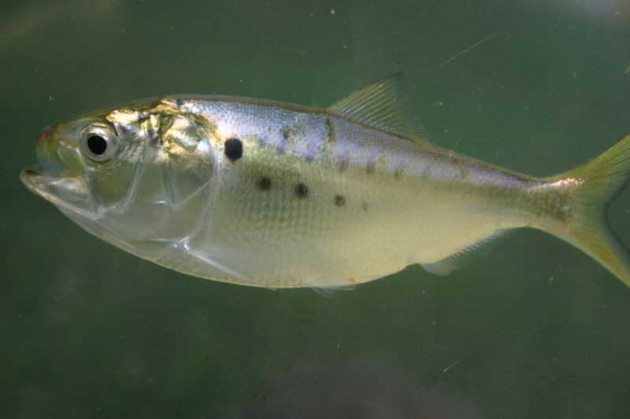
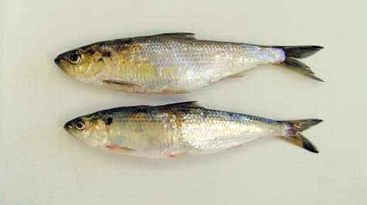
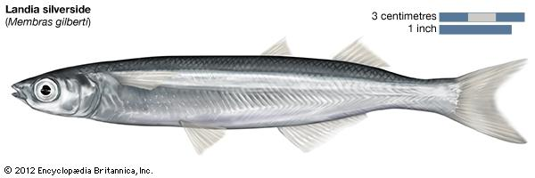
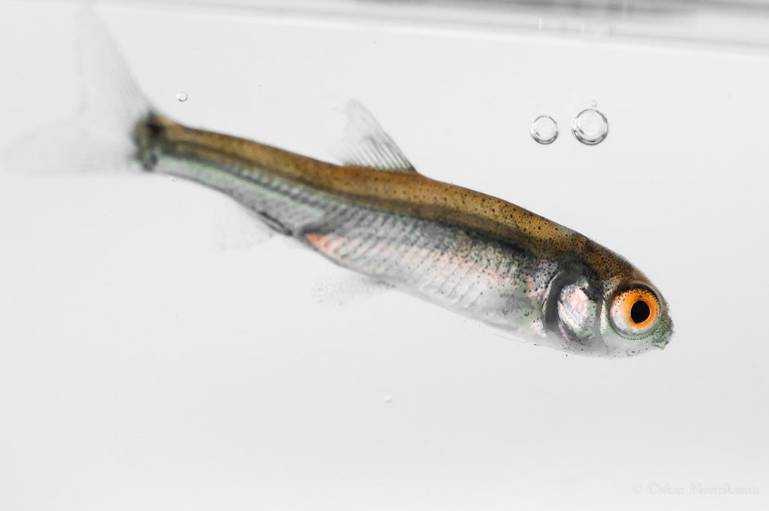
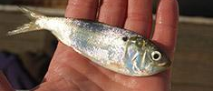
Striped bass prey: fish
Menhaden
River herring, Shad
Silversides
Other juvenile fishes
Juvenile menhaden:
peanut bunker
Notes:
Juvenile striped bass eat small insect larvae, small crustaceans, mayflies, and other larval fish.

Slide 4
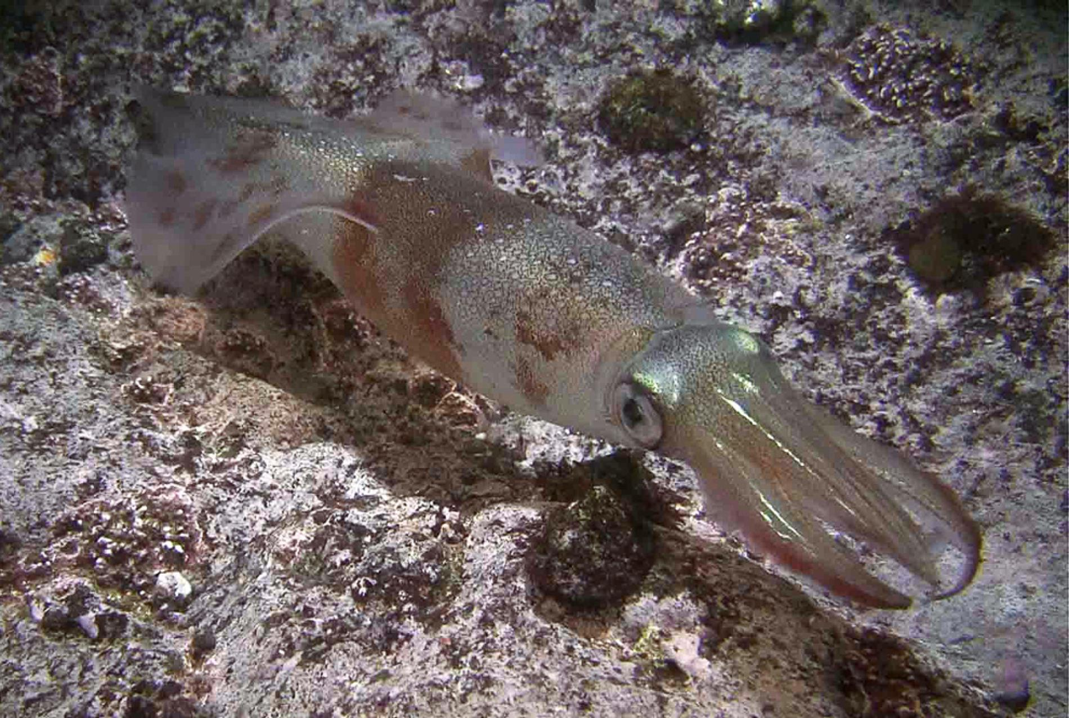
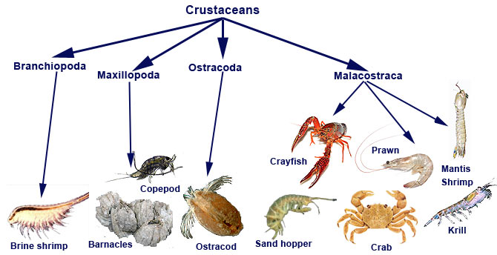
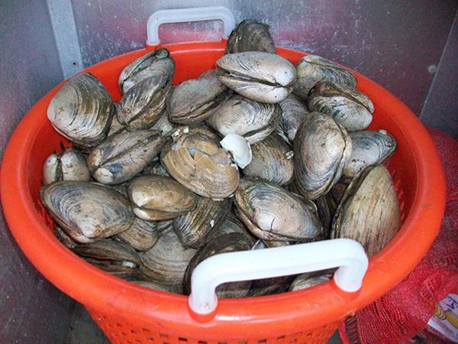
Striped bass prey: Invertebrates
Squid
Crustaceans
Bivalve Molluscs

Slide 5
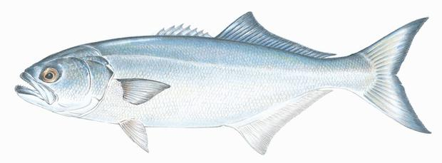
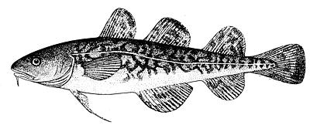
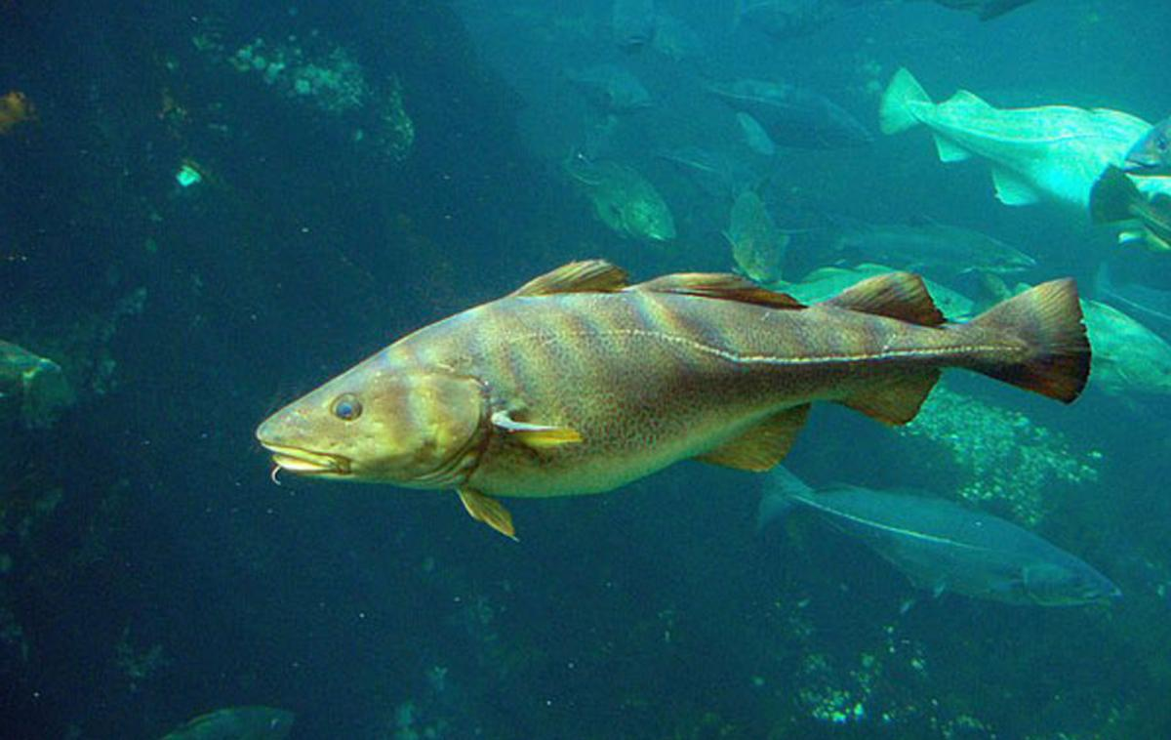
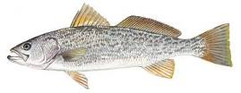
Juvenile striped bass predators
Bluefish
Atlantic tomcod
Atlantic cod
Weakfish
Silver hake
Notes:
Juvenile striped bass are eaten by other fish.
Adult striped bass are eaten by sharks,seals, humans and birds.

Slide 6
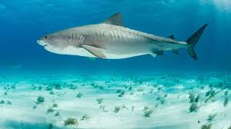
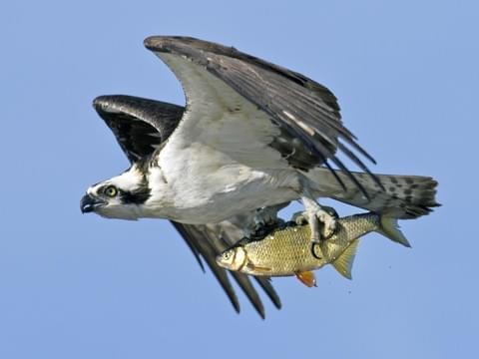
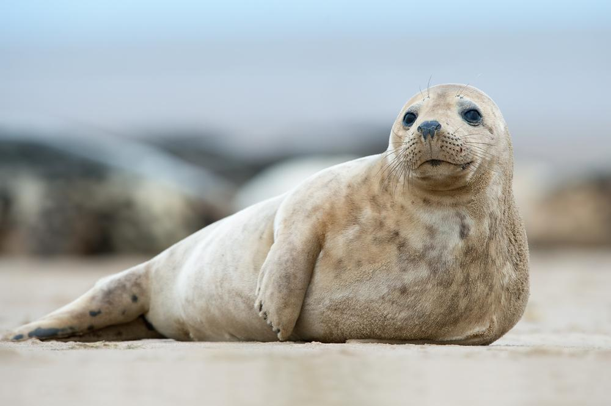
Adult striped bass predators
Sharks
Osprey
Seals
Humans

Slide 7
Striped bass
Striped bass can live for up to 30 years.
The growth of striped bass depends on where they live and the availability of food.
They can grow up to 5 feet and weigh 77 pounds or more .
Males are sexually mature between the age of 2 and 4.
Females are sexually mature between the ages of 4 and 8.
They reproduce during spring to early summer.
Major spawning grounds are in the Chesapeake Bay, Delaware Bay and Hudson River.
Notes:
Season is to protect the striped bass reproduction season
Size to protect younger fish

Slide 8
Striped bass fishing
Fishing
Striped bass are very popular recreational and commercial fish.
Regulations protect the striped bass from being overfished; regulations differ from state to state and can vary from year-to-year depending on the health of population. 2018 MA regulations include:
Commercial
The general regulations are set by the Atlantic States Marine Fisheries Commission and can be adjusted, on appeal, for each state. Not all states have a commercial striped bass fishery (e.g., Maine and New Hampshire). In MA catch quotas are set based on the total weight of fish landed. The season ends once the quota has been met. Minimum size limits (34” in MA) are used to protect younger striped bass from being caught, so they can grow, mature, and reproduce. In addition, the number of days per week (2 in MA) and the maximum number of fish per day (15) are also limited to protect the fishery.
In states with spawning grounds, the fishery is closed to protect spawning fish.
Recreational fishery
Minimum size (28” in MA) and bag limits (one per person per day).
The fishing season depends on the presence of the fish and usually lasts from May until November.

Slide 9
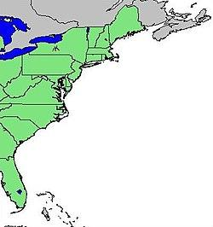
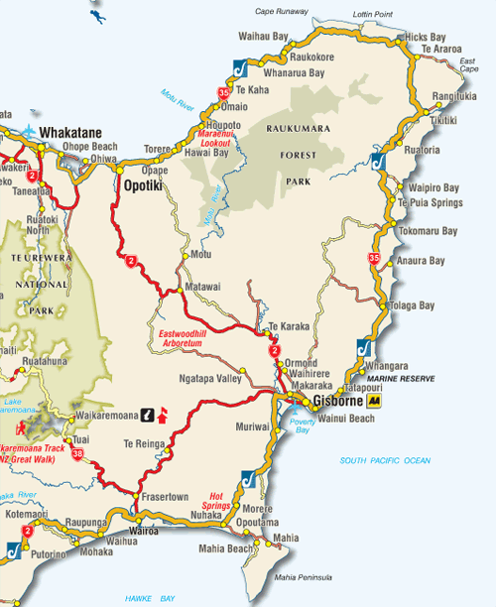
Striped bass habitat
Striped bass live along the East Coast from St. Lawrence River in Canada to St. John’s River in Florida. Striped bass were introduced to the West Coast in the 1800’s and populations of striped bass now exist in some lakes and river systems.
Striped bass have two migrations: 1) Spawning Migration, to reproduce in freshwater in the Spring and the other, 2) Coastal Migration, where fish re-enter salt water and travel for hundreds of miles northerly in the Spring and southerly in the Fall.
Major Spawning sites
Chesapeake Bay
Delaware Bay
Hudson River
Coastal movements
Spring: from the Carolinas north up the Atlantic Coast to many locations including Woods Hole.
Fall: from points north to the Carolinas.

Slide 10
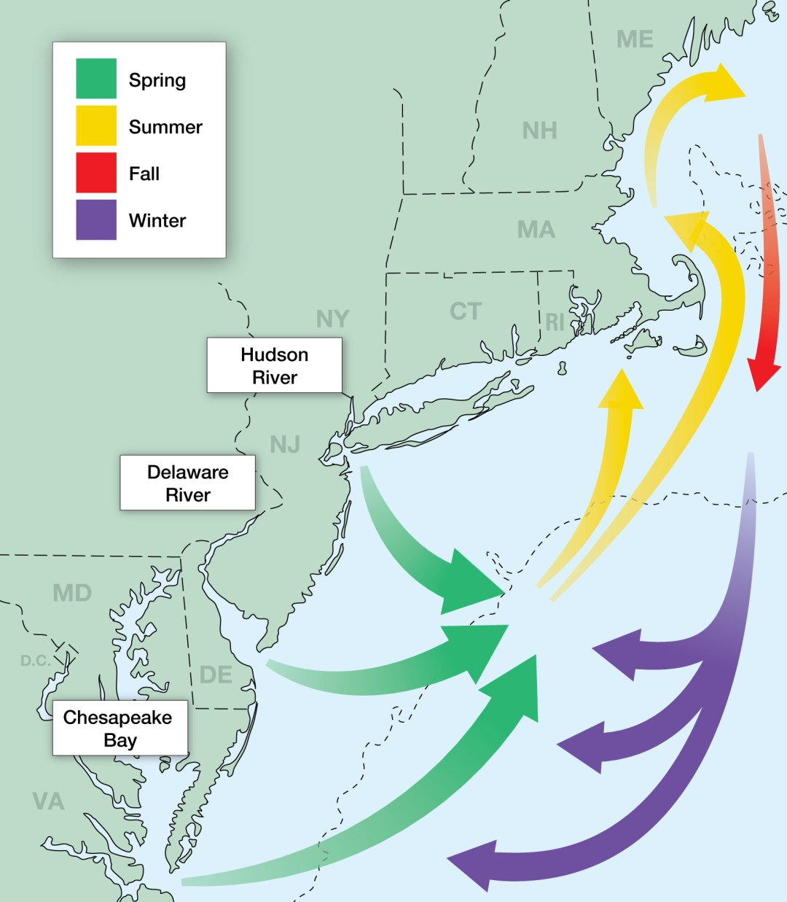
Striped bass migration
Migrate during the spring and early summer to fresh water to reproduce.
After spawning, the fish migrate north.
In the fall they migrate to the south part of the east coast
Temperature is thought to trigger migration although other environmental factors might be involved.
Storm and weather condition can affect the striped bass migration.
Food availability determines where striped bass migrate.

Slide 11
Your
turn

Slide 12
Group one- osprey( Pandion haliaetus)
What is an osprey and what makes it unique compared to other raptors?
Where do osprey live on the East Coast and where do they migrate? How does the osprey migration compare with the striped bass migration?
Are there different populations of osprey found around the world? Where do the different populations migrate?
What are the osprey prey and predators?
What is the current number of osprey?
Where are osprey located on the food chain?
What would happen if the osprey population decreases? How would this affect the striped bass?
Are osprey hunted? Are they endangered?
What do striped bass and osprey have in common given that one lives in the water and the other lives on land?

Slide 13
Group two: Menhaden (Brevoortia patronus)
What do menhaden eat?
What are menhaden’s prey and predators?
Where are menhaden found along the Atlantic Coast during each season? Include the depth at which they are found?
Do the striped bass and menhaden have any prey or predators in common?
Do menhaden migrate? How is their migration similar and different from the striped bass?
Where are menhaden on the food chain compared to striped bass?
What commercial products are made of menhaden? What happens to the striped bass food web if the menhaden are overfished?

Slide 14
Group three: Sharks (e.g., great white; Carcharodon carcharias)
What are sharks and what do they look like?
What are the prey and predators of sharks? Are striped bass their main food source?
How many species of shark are there?
Where are shark habitats?
What is the feeding behavior of sharks? When do they hunt?
If the population of sharks decreased, what might happen to the population of striped bass?
Do all the species of sharks eat striped bass?
Do sharks help control the striped bass population?
Where do sharks live compared to the areas the striped bass live?

Slide 15
Group four- small squid (longfin squid; Doryteythis pealii)
What do squids look like?
Where do they live? Bottom? Surface? What ocean (s)?
What are a squid’s prey and predators?
Do squids migrate? How does the migration relate to the striped bass migration?
Are squid caught commercially and if so, how much do they sell for? Are there laws to protect squid like those of the striped bass?
What is the squid lifespan? What are the differences between the squid lifespan and that of the striped bass?
If the population of the striped bass decreases, what would happen to the squid population?
How is the squid similar and different compared to the striped bass?

